Slide 1
Coastal Pioneer Coastal Central Inshore Profiler (CP02PMCI) Data Quality Report
Yuanyuan Xu
University of Delaware
2018-08-01

Slide 2
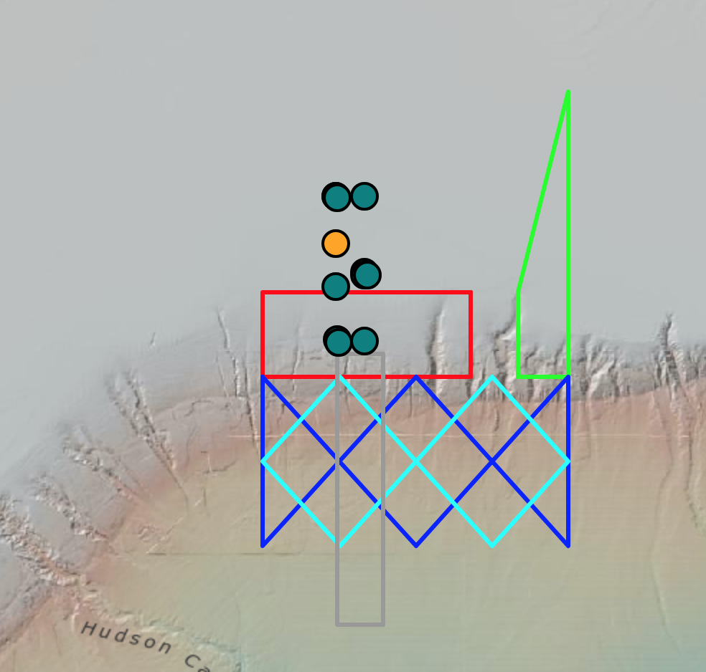
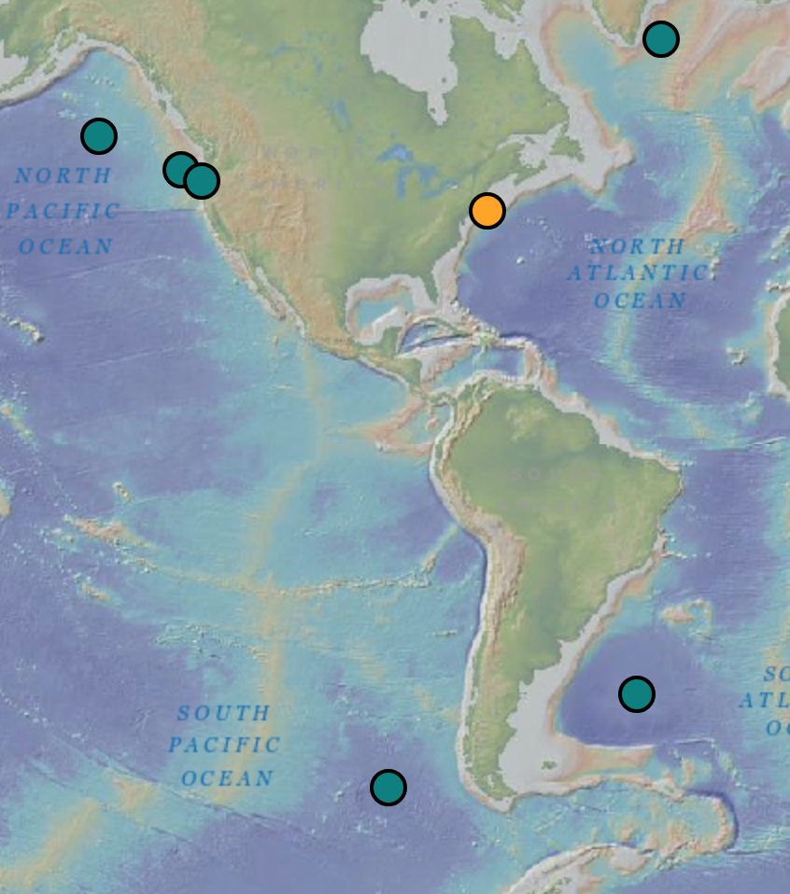
Location

Slide 3
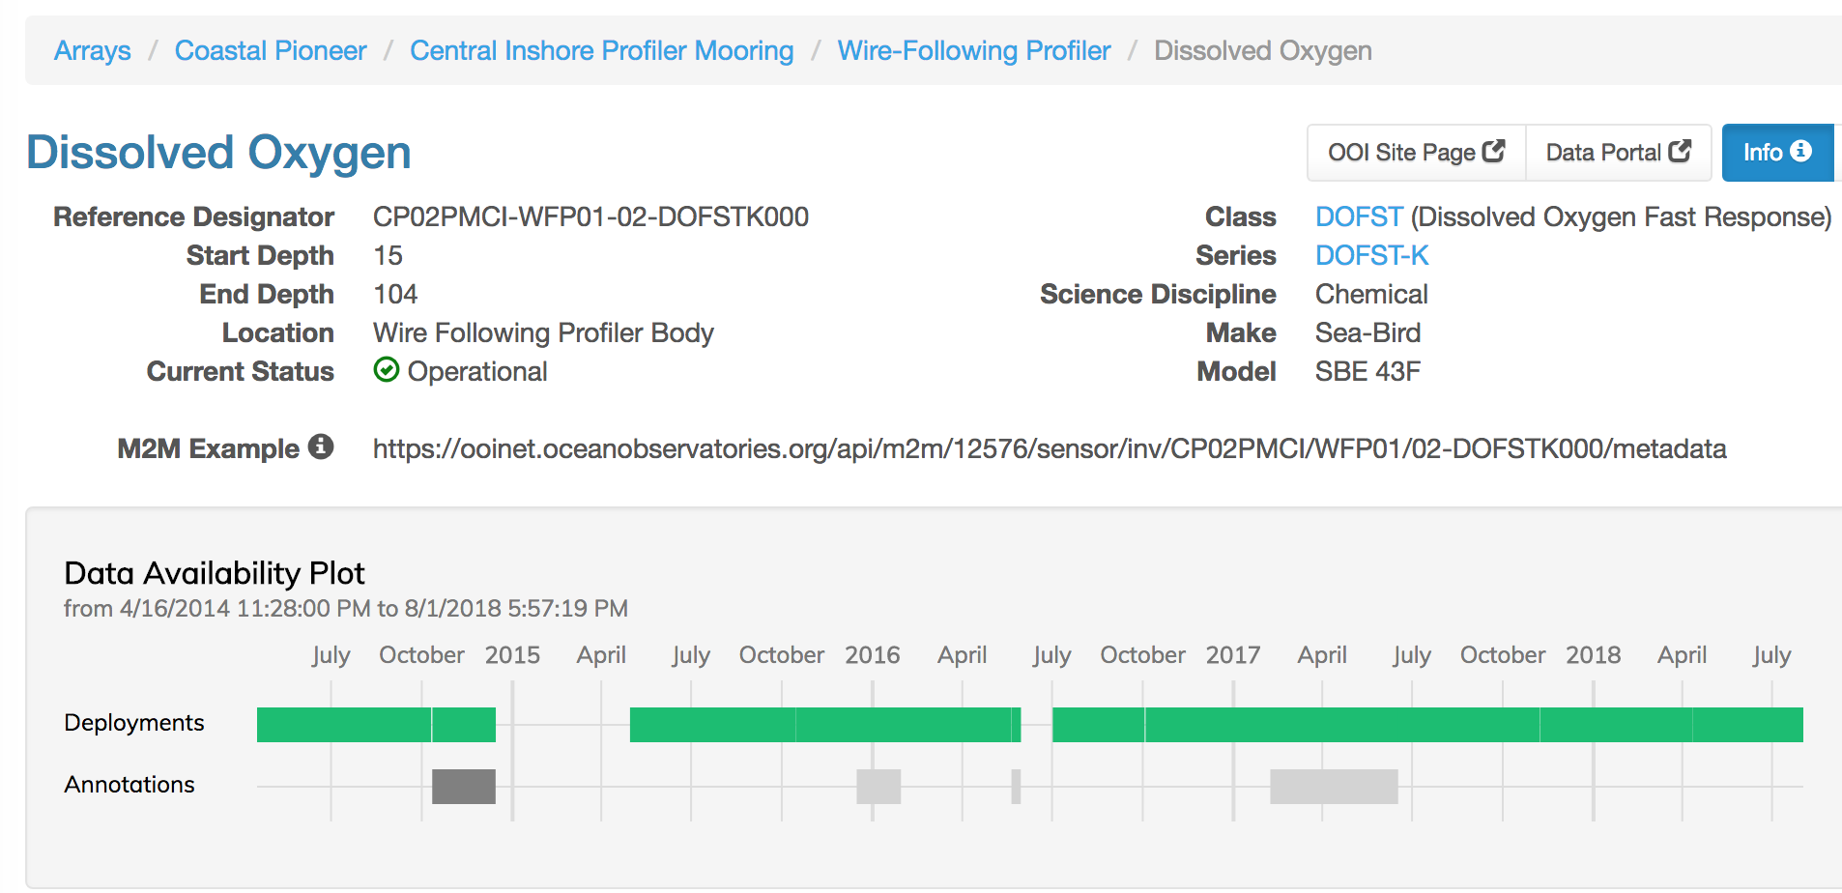
Profiler Dissolved Oxygen

Slide 4
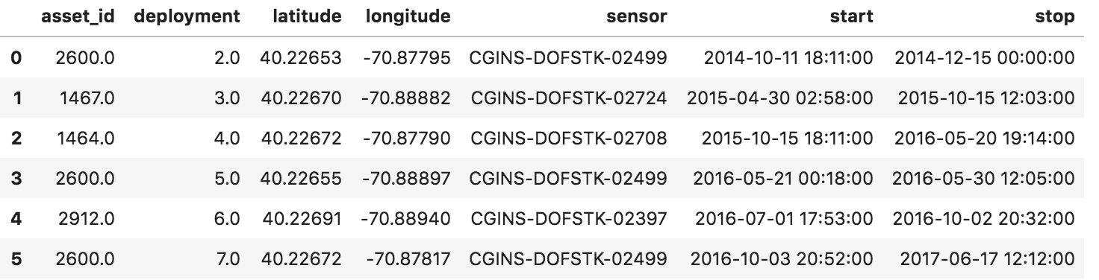
Deployment Information

Slide 5
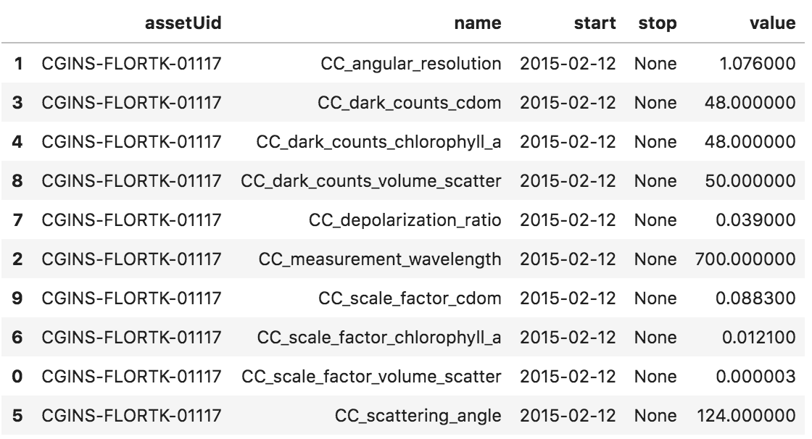
Calibration Information

Slide 6
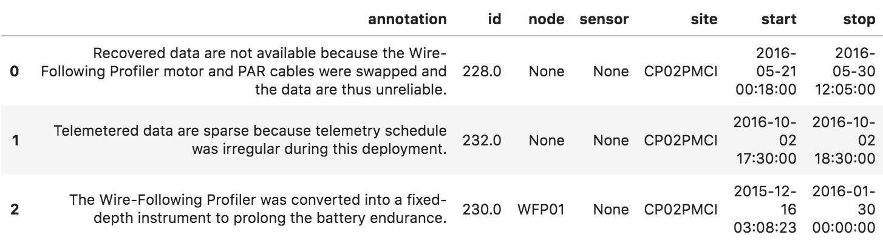
Annotations

Slide 7
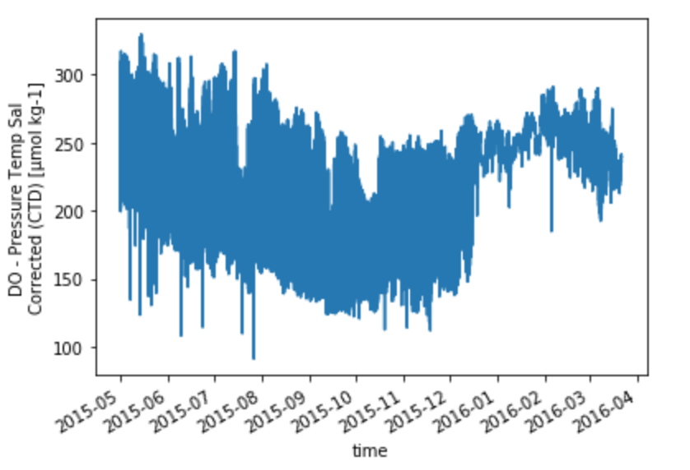
Full Time Series of Dissolved Oxygen

Slide 8
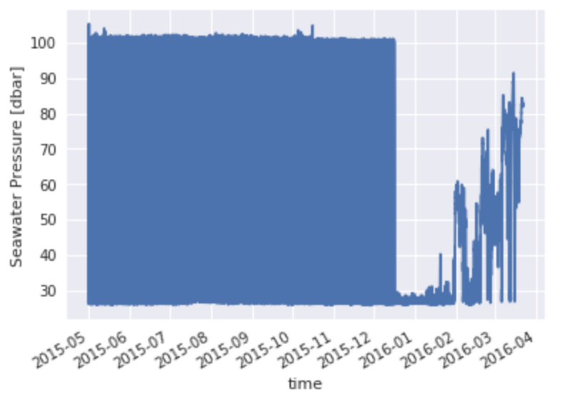
Full Time Series of Pressure

Slide 9
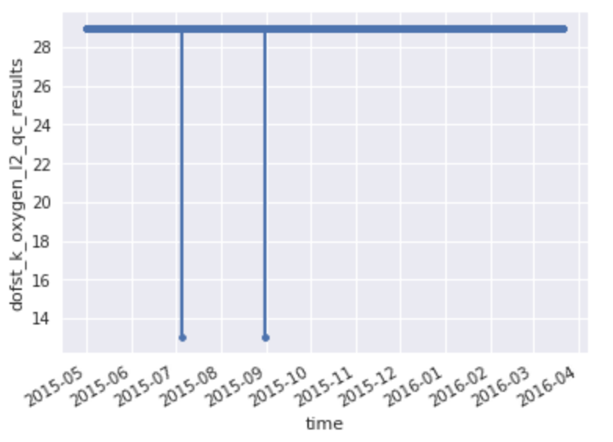
Quality Control Flag

Slide 10
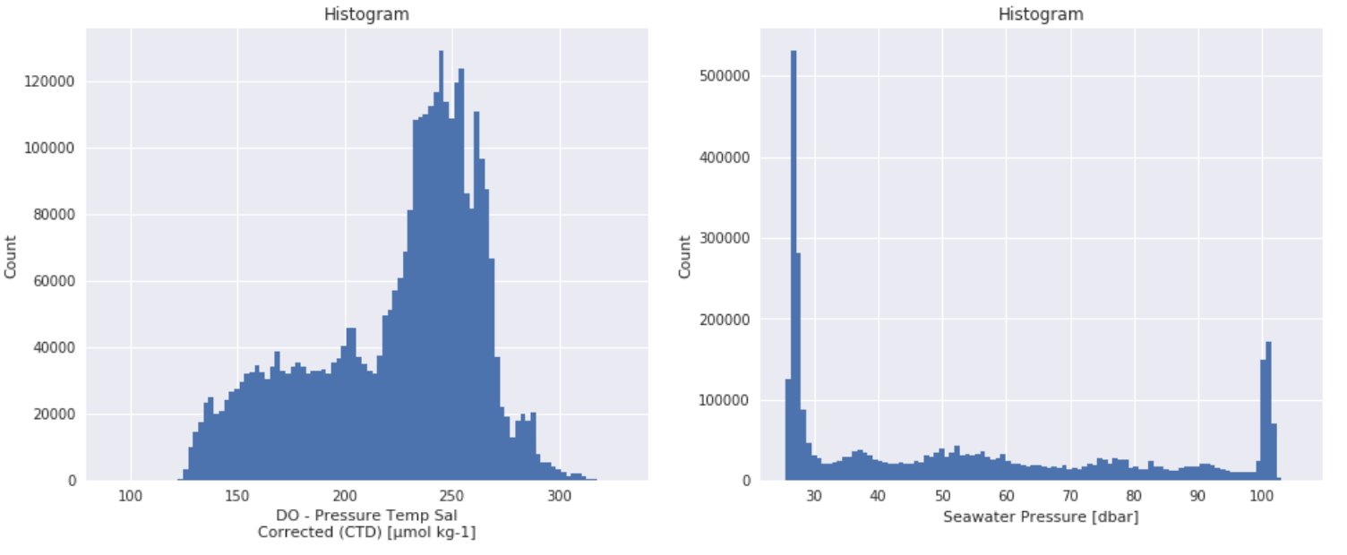
Histograms of Full Range Data

Slide 11
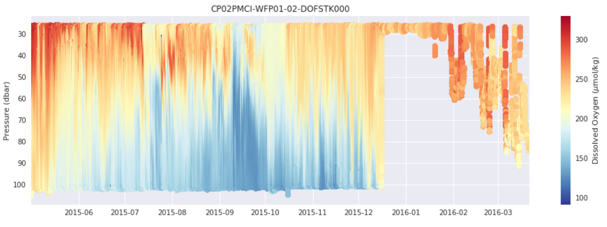
Full Range Profile Time Series

Slide 12
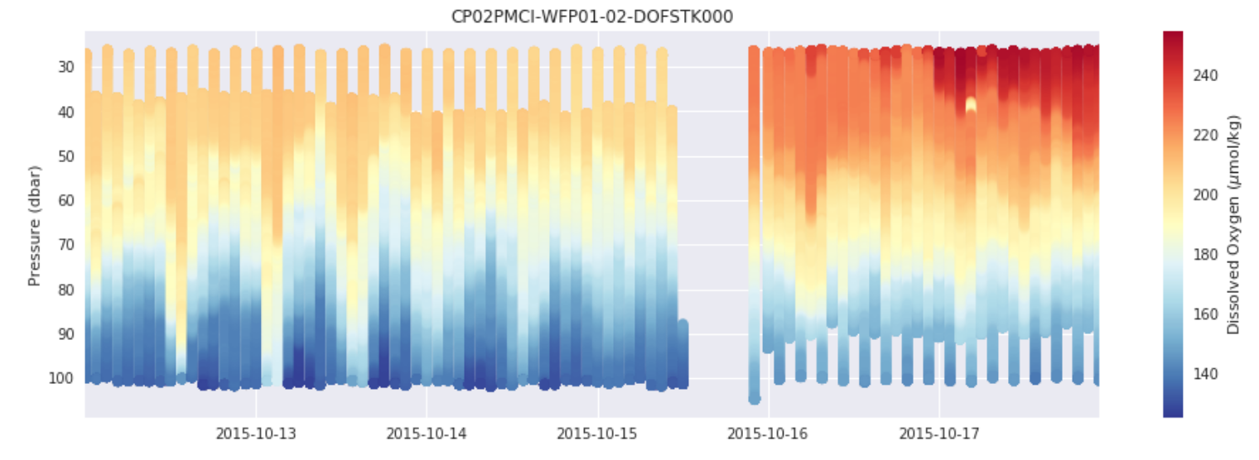
One week around the changeover

Slide 13
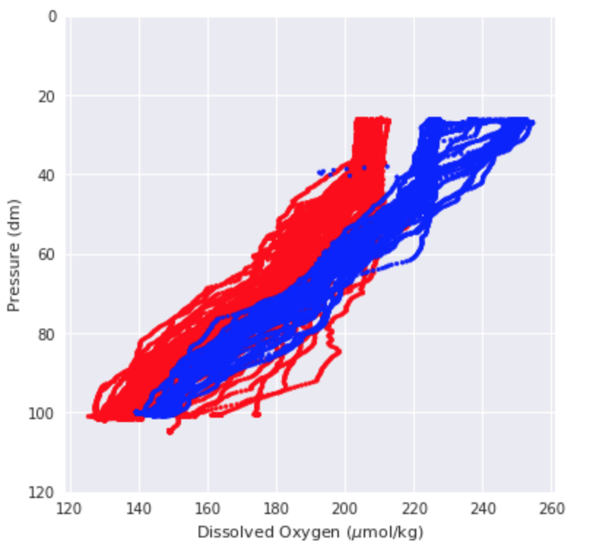
Comparison Before and After the Redeployment
Before
After

Slide 14
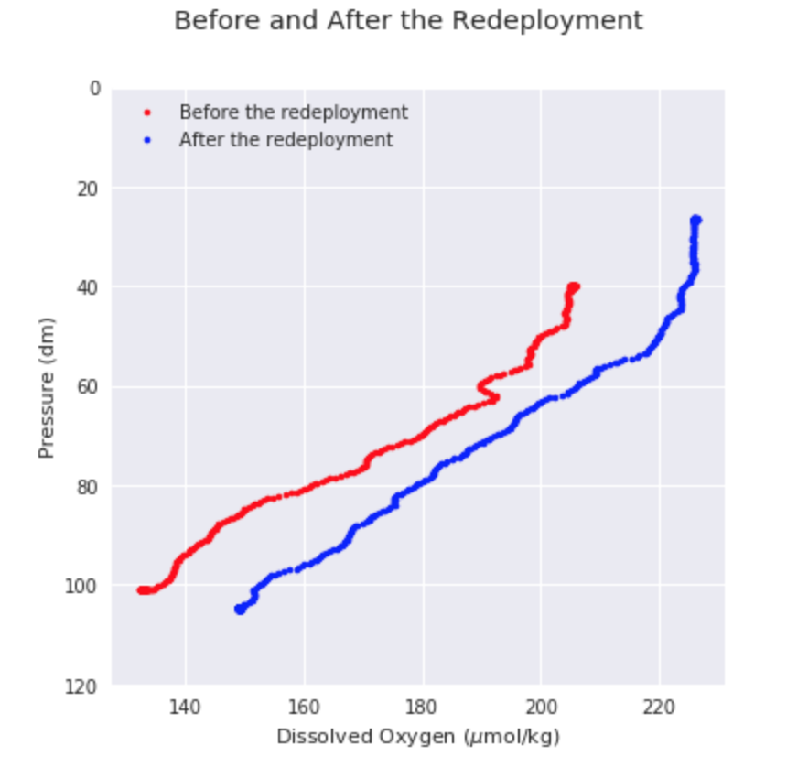
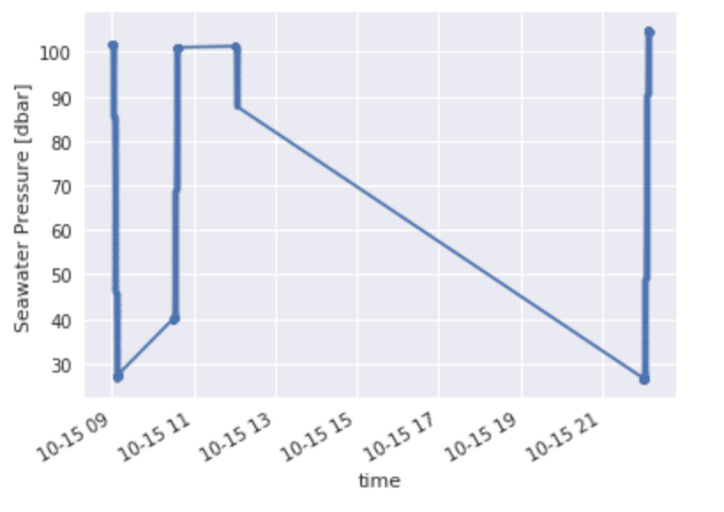
Narrow down the time range…
Before
After

Slide 15
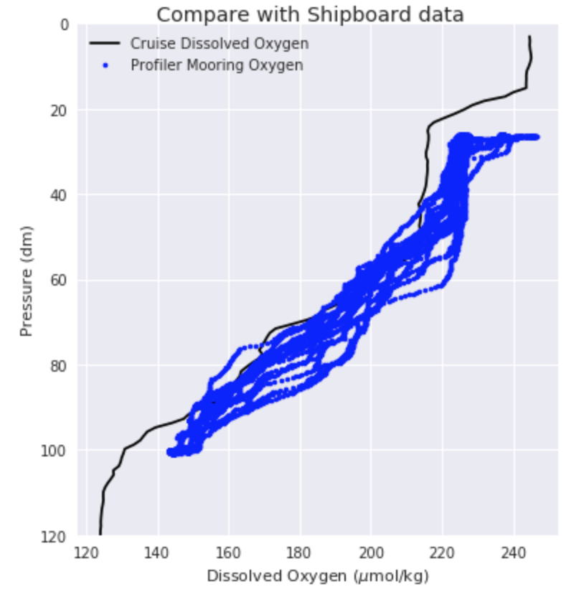
Compare with Shipboard Data

Slide 16
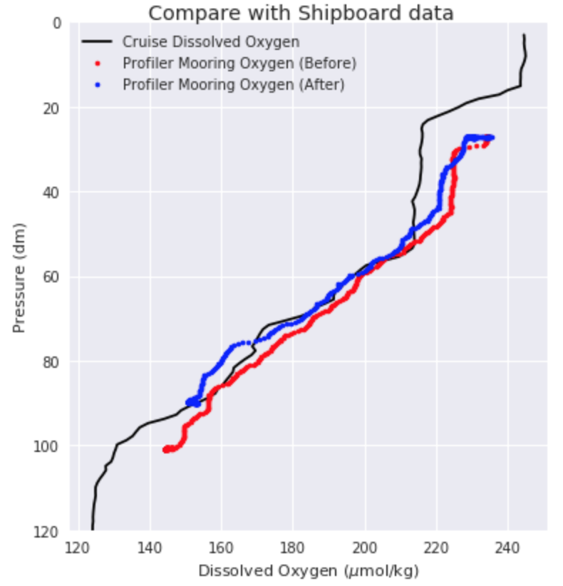
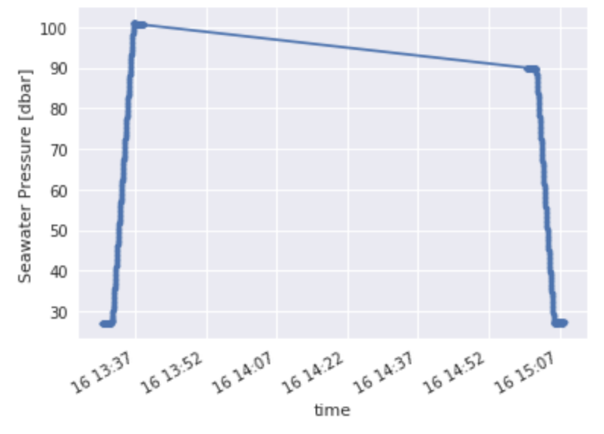
Again, narrow down the time range…

Slide 17
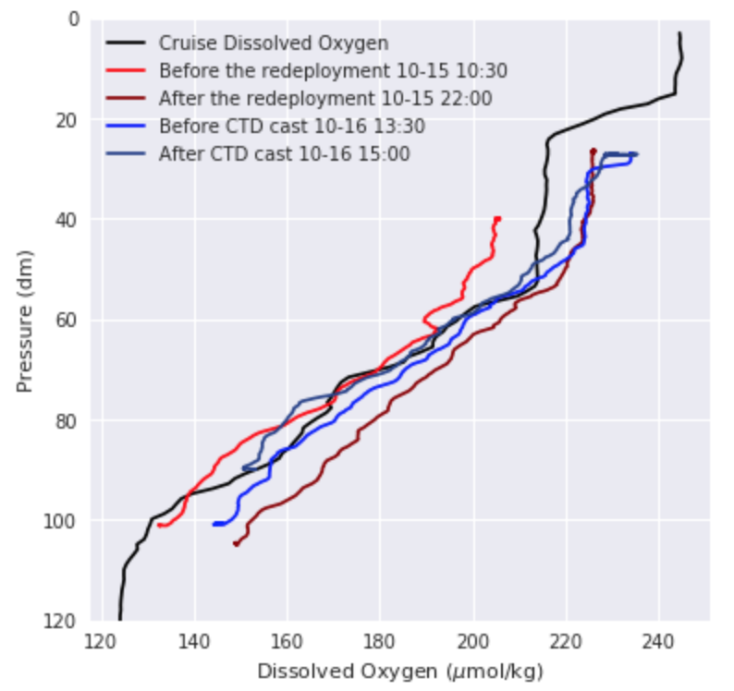
All Together…

Slide 18
Conclusions
In general, the dissolved oxygen values during deployment 4 look largely reasonable. There are no major outliers.
The data seems to align with known physical processes, though additional datasets would need to be consulted to confirm. This includes:
The surface water has higher dissolved oxygen values than the deep water.
The penetration of the dissolved oxygen decreased in the summer, which is reasonable because of the vertical mixing became weak during the summer.
The profiler was inoperative in the middle of deployment 4, remaining at approximately 30 m depth, however the dissolved oxygen data still appears reasonable. An annotation concerning this is already available in the system.
The profiler dissolved oxygen data agrees generally with a corresponding shipboard CTD cast.
The profiler dissolved oxygen sensor generally work well within half a year. No significant drift is detected in this report.
It is exciting to access OOI data using Python!!

